Slide 1
Learning Objectives
01
Understand basic data types and operators in Python
02
Implement conditional logic using if-else statements
03
Use loops to perform repetitive tasks
04
Define and call functions in Python
05
Create and use classes and objects
06
Calculate mean, median, mode, variance, and standard deviation
07
Understand and compute expectation, covariance, and correlation
08
Visualize data using Python libraries

Slide 2
Data Types and Operators in Python
Data type is a classification that specifies which type of value a variable can hold and what types of operations can be performed on it. It essentially tells the computer how to interpret and manipulate a piece of data.
Why are they important?
Memory allocation: They determine how much computer memory is needed for a variable.
Valid operations: They specify what actions can be performed on the stored data.
Data correctness: They help ensure data is used logically and prevents nonsensical operations.
Code clarity: They make the code easier to understand by showing the expected data.
Easier maintenance: Well-defined types simplify debugging and future code changes.
Performance gains: Knowing the type allows for specific optimizations by the computer.
Error prevention: They help catch mistakes early by enforcing data usage rules.

Slide 3
Static vs. Dynamic Typing
Datatypes are handled by programming languages by either of the following methods
Static Typing | Dynamic Typing
Types are checked during compilation | Types are checked during runtime
Need to explicitly declare the data type of a variable. | Don't need to explicitly declare variable types. The interpreter infers the type based on the assigned value.
Many type-related errors are caught before runtime, leading to more robust code. | Type errors might only be discovered when the program is executed.
Examples: C, C++, Java, Go, Swift, TypeScript. | Examples: Python, JavaScript, Ruby, PHP, Lua.

Slide 4
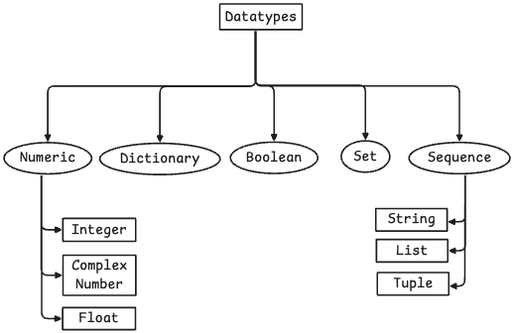
Datatypes in Python
Numeric: Represents numerical values. Example: 10, 3.14, 2+3j
Dictionary: A collection of key-value pairs. Example: {"name": "Alice", "age": 30}
Boolean: Represents truth values, either True or False. Example: True, False
Set: An unordered collection of unique elements. Example: {1, 2, 3}
Sequence: An ordered collection of items. Example: [1, 2, 3], "hello", (1, 2)
Integer: Whole numbers without a decimal point. Example: -5, 0, 100
Float: Numbers with a decimal point. Example: 3.14159, -2.7
String: An immutable sequence of characters. Example: "world", "Python"
List: A mutable sequence of items. Example: [10, "apple", True]
Tuple: An immutable sequence of items. Example: (4, 5, "banana")
Complex Number: A number with a real and an imaginary part. Example: 1+2j, -0.5-3j

Slide 5
Datatypes in Python
print("--- Numeric Types ---")
# Integer: Whole numbers (positive, negative, or zero) without a decimal point.
my_integer = 10
print(f"Value: {my_integer}, Type: {type(my_integer)}")
# Float: Numbers with a decimal point.
my_float = 3.14159
print(f"Value: {my_float}, Type: {type(my_float)}")
# Complex Number: A number with a real and an imaginary part.
my_complex = 2 + 3j
print(f"Value: {my_complex}, Type: {type(my_complex)}")
Output
--- Numeric Types ---
Value: 10, Type: <class 'int’>
Value: 3.14159, Type: <class 'float'> Value: (2+3j), Type: <class 'complex'>

Slide 6
Datatypes in Python
print("\n--- Sequence Types ---")
# String: An immutable sequence of characters.
my_string = "Hello, Python!"
print(f"Value: '{my_string}', Type: {type(my_string)}")
# List: A mutable (changeable) ordered sequence of items.
my_list = [1, "apple", True, 3.5]
print(f"Value: {my_list}, Type: {type(my_list)}")
# Tuple: An immutable (unchangeable) ordered sequence of items.
my_tuple = (10, "banana", False)
print(f"Value: {my_tuple}, Type: {type(my_tuple)}")
Output
--- Sequence Types ---
Value: 'Hello, Python!', Type: <class 'str’>
Value: [1, 'apple', True, 3.5], Type: <class 'list’>
Value: (10, 'banana', False), Type: <class 'tuple'>

Slide 7
Datatypes in Python
print("\n--- Set Types ---")
# Set: An unordered collection of unique elements.
my_set = {1, 2, 3, 2, 1} # Duplicates are automatically removed
print(f"Value: {my_set}, Type: {type(my_set)}")
print("\n--- Mapping Types ---")
# Dictionary: A collection of key-value pairs.
my_dictionary = {"name": "Alice", "age": 30, "city": "New York"}
print(f"Value: {my_dictionary}, Type: {type(my_dictionary)}")
Output
--- Set Types ---
Value: {1, 2, 3}, Type: <class 'set’>
--- Mapping Types ---
Value: {'name': 'Alice', 'age': 30, 'city': 'New York'}, Type: <class 'dict'>

Slide 8
Datatypes in Python
print("\n--- Boolean Type ---")
# Boolean: Represents truth values, either True or False.
is_active = True
print(f"Value: {is_active}, Type: {type(is_active)}")
is_done = False
print(f"Value: {is_done}, Type: {type(is_done)}")
print("\n--- None Type ---")
# NoneType: Represents the absence of a value.
no_value = None
print(f"Value: {no_value}, Type: {type(no_value)}")
Output
--- Boolean Type ---
Value: True, Type: <class 'bool'> Value: False, Type: <class 'bool’>
--- None Type ---
Value: None, Type: <class 'NoneType'>

Slide 9
Datatypes in Python
Python is dynamically typed.
Everything in Python is an object.
Mutability (changeable) vs. immutability (unchangeable) is key.
Use type() to check a variable's data type.
Integers in Python have arbitrary precision.
Strings are for text.
Integers/Floats are for numbers.
Lists are mutable ordered collections.
Tuples are immutable ordered collections.
Dictionaries map keys to values.
Sets store unique elements.
You can explicitly convert data types (e.g., int(), str())
Mutable Datatypes: list, dictionary, set, bytearray
Immutable Datatypes: int, float, complex, str, tuple, frozenset, bytes, bool, NoneType (represented by None)

Slide 10
Typecasting in Python
Implicit Type Conversion (Coercion): Implicit type conversion, also known as coercion, is when Python automatically converts one data type to another without any explicit instruction from the programmer. This typically happens in situations where Python can safely convert a "smaller" or less complex data type to a "larger" or more complex one to avoid data loss, especially in arithmetic operations.
Explicit Type Conversion (Type Casting): Explicit type conversion, or type casting, is when the programmer intentionally converts a data type of an object to a desired data type. This is done using built-in functions that act as constructors for specific types, such as int(), float(), str(), list(), tuple(), etc. This allows for precise control over the conversion process, even if it might lead to data loss (e.g., converting a float to an integer truncates the decimal part).

Slide 11
Typecasting in Python
print("--- Implicit Type Conversion ---") # Example: int + float -> float
a = 5
b = 2.5
c = a + b
print(f"5 (int) + 2.5 (float) = {c} (type: {type(c)})")
print("-" * 20)
print("\n--- Explicit Type Conversion ---") # Example: float to int (truncates)
num_float = 9.81
num_int_cast = int(num_float)
print(f"int(9.81) = {num_int_cast} (type: {type(num_int_cast)})")
print("-" * 20)
Output
--- Implicit Type Conversion ---
5 (int) + 2.5 (float) = 7.5 (type: <class 'float’>)
--------------------
--- Explicit Type Conversion ---
int(9.81) = 9 (type: <class 'int’>)
--------------------

Slide 12
Operators
What are Operators?
Operators are special symbols or keywords that perform operations on one or more operands (values or variables).
For example, in the expression '5 + 3', '+' is the operator, and '5' and '3' are the operands.
Types of Operators
Arithmetic
Comparison
Assignment
Logical
Bitwise
Identity
Membership

Slide 13
Operators
Arithmetic Operators: Perform mathematical calculations.
+ (Addition): Adds two operands.
- (Subtraction): Subtracts the second operand from the first.
* (Multiplication): Multiplies two operands.
/ (Division): Divides the first operand by the second, always returning a float.
% (Modulus): Returns the remainder of the division.
** (Exponentiation): Raises the first operand to the power of the second.
// (Floor Division): Returns the integer part of the division.

Slide 14
Operators
Comparison (Relational) Operators: Compare two values and return a Boolean (True or False) result.
== (Equal to): True if operands are equal.
!= (Not equal to): True if operands are not equal.
> (Greater than): True if the first operand is greater than the second.
< (Less than): True if the first operand is less than the second.
>= (Greater than or equal to): True if the first operand is greater than or equal to the second.
<= (Less than or equal to): True if the first operand is less than or equal to the second.

Slide 15
Operators
Comparison (Relational) Operators: Compare two values and return a Boolean (True or False) result.
== (Equal to): True if operands are equal.
!= (Not equal to): True if operands are not equal.
> (Greater than): True if the first operand is greater than the second.
< (Less than): True if the first operand is less than the second.
>= (Greater than or equal to): True if the first operand is greater than or equal to the second.
<= (Less than or equal to): True if the first operand is less than or equal to the second.

Slide 16
Operators
Assignment Operators: Assign values to variables.
= (Assignment): Assigns the value of the right operand to the left operand.
+= (Add AND assignment): Adds right operand to left operand and assigns the result to left operand.
-= (Subtract AND assignment): Subtracts right operand from left operand and assigns the result to left operand.
*= (Multiply AND assignment): Multiplies right operand with left operand and assigns the result to left operand.
/= (Divide AND assignment): Divides left operand by right operand and assigns the result to left operand.
%= (Modulus AND assignment): Takes modulus using two operands and assigns the result to left operand.
**= (Exponent AND assignment): Performs exponential calculation on operands and assigns value to the left operand.
//= (Floor Divide AND assignment): Performs floor division on operands and assigns value to the left operand.

Slide 17
Operators
Logical Operators: Combine conditional statements (Boolean expressions).
and: Returns True if both operands are True.
or: Returns True if at least one operand is True.
not: Inverts the Boolean value of the operand.

Slide 18
Operators
Bitwise Operators: Act on operands as if they were sequences of binary digits (bits).
& (Bitwise AND): Sets each bit to 1 if both bits are 1.
| (Bitwise OR): Sets each bit to 1 if at least one of the bits is 1.
^ (Bitwise XOR): Sets each bit to 1 if only one of the bits is 1.
~ (Bitwise NOT): Inverts all the bits.
<< (Left Shift): Shifts bits to the left, filling with zeros on the right.
>> (Right Shift): Shifts bits to the right, filling with sign bit on the left (for signed numbers).

Slide 19
Operators
Identity Operators: Compare the memory locations of two objects.
is: Returns True if both variables point to the same object.
is not: Returns True if both variables do NOT point to the same object.
Membership Operators: Test if a sequence (string, list, tuple, set, dictionary) contains a specific value.
in: Returns True if the value is found in the sequence.
not in: Returns True if the value is NOT found in the sequence.

Slide 20
Operators
print("--- 1. Arithmetic Operators ---")
x = 15
y = 4 print(f"x = {x}, y = {y}")
print(f"x + y = {x + y}")
print(f"x - y = {x - y}")
print(f"x * y = {x * y}")
print(f"x / y = {x / y}")
print(f"x % y = {x % y}")
print(f"x ** y = {x ** y}")
print(f"x // y = {x // y}")
Output
--- 1. Arithmetic Operators ---
x = 15, y = 4 x + y = 19
x - y = 11
x * y = 60
x / y = 3.75
x % y = 3
x ** y = 50625
x // y = 3

Slide 21
Operators
print("\n--- 2. Comparison (Relational) Operators ---")
a = 10
b = 20
c = 10
print(f"a = {a}, b = {b}, c = {c}")
print(f"a == b: {a == b}")
print(f"a == c: {a == c}")
print(f"a != b: {a != b}")
print(f"a > b: {a > b}")
print(f"a < b: {a < b}")
print(f"a >= c: {a >= c}")
print(f"a <= b: {a <= b}")
Output
--- 2. Comparison (Relational) Operators ---
a = 10, b = 20, c = 10
a == b: False
a == c: True
a != b: True
a > b: False
a < b: True
a >= c: True
a <= b: True

Slide 22
Operators
print("\n--- 3. Assignment Operators ---")
val = 5
print(f"Initial val = {val}")
my_var = 10
print(f"my_var = {my_var}")
val += 3
print(f"val += 3: {val}")
val -= 2
print(f"val -= 2: {val}")
val *= 4
print(f"val *= 4: {val}")
val /= 3
print(f"val /= 3: {val}")
val = 17
val %= 5
print(f"val %= 5: {val}")
val = 2
val **= 3
print(f"val **= 3: {val}")
val = 25
val //= 4
print(f"val //= 4: {val}")
Output
--- 3. Assignment Operators ---
Initial val = 5
my_var = 10
val += 3: 8
val -= 2: 6
val *= 4: 24
val /= 3: 8.0
val %= 5: 2
val **= 3: 8
val //= 4: 6

Slide 23
Operators
print("\n--- 4. Logical Operators ---")
is_sunny = True
is_warm = False
has_umbrella = True
print(f"is_sunny = {is_sunny}, is_warm = {is_warm}, has_umbrella = {has_umbrella}")
print(f"is_sunny and is_warm: {is_sunny and is_warm}")
print(f"is_sunny or is_warm: {is_sunny or is_warm}")
print(f"not is_warm: {not is_warm}")
Output
--- 4. Logical Operators ---
is_sunny = True, is_warm = False, has_umbrella = True
is_sunny and is_warm: False
is_sunny or is_warm: True
not is_warm: True

Slide 24
Operators
print("\n--- 5. Bitwise Operators ---")
num1 = 10
num2 = 4
print(f"num1 = {num1} (binary: {bin(num1)})")
print(f"num2 = {num2} (binary: {bin(num2)})")
print(f"num1 & num2: {num1 & num2} (binary: {bin(num1 & num2)})")
print(f"num1 | num2: {num1 | num2} (binary: {bin(num1 | num2)})")
print(f"num1 ^ num2: {num1 ^ num2} (binary: {bin(num1 ^ num2)})")
print(f"~num1: {~num1} (binary: {bin(~num1)})")
print(f"num1 << 2: {num1 << 2} (binary: {bin(num1 << 2)})")
print(f"num1 >> 2: {num1 >> 2} (binary: {bin(num1 >> 2)})")
Output
--- 5. Bitwise Operators ---
num1 = 10 (binary: 0b1010)
num2 = 4 (binary: 0b100)
num1 & num2: 0 (binary: 0b0)
num1 | num2: 14 (binary: 0b1110)
num1 ^ num2: 14 (binary: 0b1110)
~num1: -11 (binary: -0b1011)
num1 << 2: 40 (binary: 0b101000)
num1 >> 2: 2 (binary: 0b10)

Slide 25
Operators
print("\n--- 6. Identity Operators ---")
list1 = [1, 2, 3]
list2 = [1, 2, 3]
list3 = list1
print(f"list1: {list1}, list2: {list2}, list3: {list3}")
print(f"list1 is list2: {list1 is list2}")
print(f"list1 is list3: {list1 is list3}")
print(f"list1 is not list2: {list1 is not list2}")
Output
--- 6. Identity Operators ---
list1: [1, 2, 3], list2: [1, 2, 3], list3: [1, 2, 3]
list1 is list2: False
list1 is list3: True
list1 is not list2: True

Slide 26
Operators
print("\n--- 7. Membership Operators ---")
my_string_seq = "Python Programming"
my_list_seq = [10, 20, 30, 40]
my_dict_seq = {"name": "Eve", "age": 25}
print(f"my_string_seq: '{my_string_seq}'")
print(f"my_list_seq: {my_list_seq}")
print(f"my_dict_seq: {my_dict_seq}")
print(f"'P' in my_string_seq: {'P' in my_string_seq}")
print(f"'x' in my_string_seq: {'x' in my_string_seq}")
print(f"20 in my_list_seq: {20 in my_list_seq}")
print(f"50 in my_list_seq: {50 in my_list_seq}")
print(f"'name' in my_dict_seq: {'name' in my_dict_seq}")
print(f"'Eve' in my_dict_seq: {'Eve' in my_dict_seq}")
print(f"'Z' not in my_string_seq: {'Z' not in my_string_seq}")
print(f"15 not in my_list_seq: {15 not in my_list_seq}")
Output
--- 7. Membership Operators ---
my_string_seq: 'Python Programming'
my_list_seq: [10, 20, 30, 40]
my_dict_seq: {'name': 'Eve', 'age': 25}
'P' in my_string_seq: True
'x' in my_string_seq: False
20 in my_list_seq: True
50 in my_list_seq: False
'name' in my_dict_seq: True
'Eve' in my_dict_seq: False
'Z' not in my_string_seq: True
15 not in my_list_seq: True

Slide 27
Conditional Statements in Python
These are programming constructs that allow you to control the order in which code is executed based on whether certain conditions are met (evaluated as True or False). They enable your program to make decisions and follow different paths of execution. Essentially, they dictate the "flow" of your program's logic.
if: Executes a code block if its condition is True.
elif: Checks additional conditions if the preceding
if/elif were False. Only the first True elif's block runs.
else: Executes its code block if no preceding if/elif condition was True. Acts as a default.
They control the flow of execution based on conditions.
There can be zero or more elif statements after an if.
There can be at most one else statement, and it must come at the end. Code blocks within if/elif/else are indented

Slide 28
Why Use Conditional Statements?
Make Decisions in Code: Conditional statements are the tools that allow your programs to analyze situations and choose different actions accordingly. Just like you decide what to wear based on the weather, your code can decide what to do based on data.
Control the Flow Based on Conditions: Instead of executing every line of code sequentially, conditional statements let you create branches in your program's path. Certain blocks of code will only run if specific conditions are True, giving you precise control over what happens and when.
Core to Logic-Building and Problem-Solving: At the heart of most complex programs lies a series of logical decisions. Conditional statements are fundamental for implementing this logic, enabling you to solve problems by breaking them down into different scenarios and handling each one appropriately.

Slide 29
Syntax for If-elif-else Loops
if condition1:
# block of code if condition1 is true
elif condition2:
# block of code if condition2 is true
elif condition3:
# block of code if condition3 is true
else:
# block of code if none of the above conditions are true
Python uses indentation (whitespace at the beginning of a line) to define code blocks.
All statements within an if, elif, or else block must be indented at the same level.
Typically, four spaces are used for each level of indentation.
Incorrect indentation will lead to IndentationError and your program won't run correctly. This is how Python knows which lines of code belong to which conditional branch.

Slide 30
Example
num = 7
if num % 2 == 0:
print("Even")
else:
print("Odd")
Output
Odd

Slide 31
While Loop
A while loop in Python is a control flow statement that repeatedly executes a block of code as long as a specified condition remains true. It continues to iterate until the condition becomes false.
General Syntax
while condition:
# Code to be executed as long as the condition is true
# It's important to have code here that can eventually make the condition false
Example:
count = 1
while count <= 5:
print(count)
count = count + 1
print("Loop finished!")
Output
1
2
3
4
5
Loop Finished

Slide 32
Match Case
A more structured and readable way to handle multiple conditional checks, especially when dealing with different data structures or specific values.
Example
# Matching a number
code = 200
match code:
case 200: print("Success")
case 404: print("Error")
case _: print("Something else")
print("-" * 10)
# Matching a command
action = "close"
match action:
case "open": print("Opening")
case "close": print("Closing")
case _: print("Doing nothing")
Output
Success
----------
Closing

Slide 33
For Loop
for variable in sequence:
# code block to execute
Example
fruits = ["apple", "banana", "cherry"]
for fruit in fruits:
print(fruit)
Output
apple
banana
cherry

Slide 34
Use cases of loops
Problem 1:Print each fruit in a list
fruits = ["apple", "banana", "cherry", "date"]
print("--- Using a for loop to print fruits ---")
for fruit in fruits:
print(f"I like {fruit}.")
print("\nAll fruits processed.")
Output
--- Using a for loop to print fruits ---
I like apple.
I like banana.
I like cherry.
I like date.
All fruits processed.

Slide 35
Use cases of loops
Problem 2: Calculate the sum of numbers from 1 to 10
total_sum = 0
number = 1
print("--- Using a while loop to sum numbers ---")
while number <= 10:
total_sum += number
total_sum number += 1
print(f"The sum of numbers from 1 to 10 is: {total_sum}")
another_sum = 0
print("\n--- Using a for loop with range to sum numbers ---")
for i in range(1, 11):
another_sum += i
print(f"The sum of numbers from 1 to 10 (using for loop) is: {another_sum}")
Output
--- Using a while loop to sum numbers ---
The sum of numbers from 1 to 10 is: 55
--- Using a for loop with range to sum numbers ---
The sum of numbers from 1 to 10 (using for loop) is: 55

Slide 36
Use cases of loops
Problem 3: Ask the user for a positive number until valid input is received
valid_input = False
user_number = 0
print("--- Using a while loop for input validation ---")
while not valid_input:
try:
user_input = input("Please enter a positive number: ")
user_number = int(user_input)
if user_number > 0:
valid_input = True
else:
print("That's not a positive number. Please try again.")
except ValueError:
print("Invalid input. Please enter a whole number.")
print(f"You entered a valid positive number: {user_number}")
Output
--- Using a while loop for input validation ---
Please enter a positive number: 0
That's not a positive number. Please try again.
Please enter a positive number: 100
You entered a valid positive number: 100

Slide 37
Defining and Calling Functions in Python
In Python, a function is a block of organized, reusable code that performs a specific task. Functions help to break down larger programs into smaller, more manageable, and modular pieces. They promote code reusability and make your code easier to read and maintain.
Parameters: Variables defined inside the parentheses of the function definition. They act as placeholders for the values that will be passed to the function when it's called.
Arguments: The actual values that are passed to a function when it is called. These values are assigned to the corresponding parameters.
Return Value: A function can optionally return a value back to the caller using the return statement. If a return statement is not present, or if return is used without an expression, the function implicitly returns None.
Scope: Variables defined inside a function have local scope, meaning they are only accessible within that function.

Slide 38
Use case of Functions in Python
Problem: Calculate the area of a rectangle.
Solution:
Define the function The 'calculate_rectangle_area' function takes two parameters: 'length' and 'width’. It calculates their product and returns the result.
Call the function We call the 'calculate_rectangle_area' function with specific arguments (values). The returned value is then stored in a variable and printed.

Slide 39
Use case of Functions in Python
def calculate_rectangle_area(length, width):
"""
This function calculates the area of a rectangle.
Parameters:
length (float or int): The length of the rectangle.
width (float or int): The width of the rectangle.
Returns:
float or int: The calculated area of the rectangle.
"""
area = length * width
return area

Slide 40
Use case of Functions in Python
# Example 1: Calculate area for a rectangle with length 10 and width 5
rect1_length = 10
rect1_width = 5
area1 = calculate_rectangle_area(rect1_length, rect1_width)
print(f"The area of rectangle 1 (length={rect1_length}, width={rect1_width}) is: {area1}")
# Example 2: Calculate area for a rectangle with length 7.5 and width 3.2
rect2_length = 7.5
rect2_width = 3.2
area2 = calculate_rectangle_area(rect2_length, rect2_width)
print(f"The area of rectangle 2 (length={rect2_length}, width={rect2_width}) is: {area2}")
Output
The area of rectangle 1 (length=10, width=5) is: 50
The area of rectangle 2 (length=7.5, width=3.2) is: 24.0
The area of rectangle 3 (length=12, width=8) is: 96

Slide 41
Programming Paradigms
Programming paradigms are fundamental styles or ways of thinking about how to structure and organize your code. They are not languages themselves, but rather methodologies that languages can support. Understanding them helps you choose the right approach for different problems and write more effective code.
Imperative Programming - Focuses on how to achieve a result by explicitly stating the sequence of steps the program should execute. - Uses statements that change a program’s state - Emphasizes control flow through loops, conditionals and function cells
Declarative Programming - Focuses on what the program should accomplish without specifying the explicit control flow. The desired outcome is described, and the system flow figures out how to get there - Avoids side effects and mutable state - Often relies on expressions and transformations

Slide 42
Programming Paradigms
Object Oriented Programming - Organizes software design around objects which combine data and behaviour into a single unit. It models real world entities - Encapsulation: Bundling data and methods that operate on the data within a single unit - Inheritance: Allows new classes to inherit properties and behaviours from existing classes - Polymorphism: Objects of different classes can be treated as objects of a common type - Abstraction: Hiding complex implementation details and showing only essential features
Event Driven Programming - The flow of the program is determined by events (user clicks, key presses, etc.). - The program waits for the events and reacts to them - Uses event handlers or callbacks that are triggered when a specific event occurs - Often used in GUIs, web applications and real time systems

Slide 43
Programming Paradigms
Problem: Calculating the sum of all numbers in a given list
1. Imperative Programming Paradigm
Focuses on 'how' to achieve the result by explicitly stating steps and managing state.
def sum_imperative(numbers):
total = 0 # Initialize a mutable state variable
for number in numbers: # Explicitly iterate through the list
total = total + number # Explicitly update the state in each step
return total
my_list_imperative = [1, 2, 3, 4, 5]
result_imperative = sum_imperative(my_list_imperative)
print(f"List: {my_list_imperative}")
print(f"Sum (Imperative): {result_imperative}")

Slide 44
Programming Paradigms
Problem: Calculating the sum of all numbers in a given list
2. Declarative Paradigm
Using Python's built-in sum() function (highly declarative)
Declare 'what' you want (the sum), not 'how' to sum it.
def sum_declarative_builtin(numbers):
return sum(numbers)
my_list_declarative_builtin = [10, 20, 30, 40]
result_declarative_builtin = sum_declarative_builtin(my_list_declarative_builtin)
print(f"List: {my_list_declarative_builtin}")
print(f"Sum (Declarative - Built-in sum()): {result_declarative_builtin}")

Slide 45
Programming Paradigms
Problem: Calculating the sum of all numbers in a given list
3. Object-Oriented Programming (OOP) Paradigm
Organizes code around 'objects' that combine data (attributes) and behavior (methods).
class NumberAggregator:
def __init__(self, numbers_list):
self.numbers = numbers_list
def calculate_sum(self):
total = 0
for num in self.numbers:
total += num
return total
my_numbers_obj = NumberAggregator([100, 200, 300])
print(f"Numbers in object: {my_numbers_obj.numbers}")
result_oop = my_numbers_obj.calculate_sum()
print(f"Sum (OOP): {result_oop}")

Slide 46
Programming Paradigms
Problem: Calculating the sum of all numbers in a given list
4. Event-Driven Programming Paradigm (Simulated)
- The flow is determined by 'events'. Here, a function acts as an 'event handler’ that is triggered by a simulated event (a direct function call).
- In a real GUI or web app, this would be a button click, data arrival, etc.
def on_data_received_and_sum(data_payload):
print(f"Event: 'data_received' triggered with payload: {data_payload}")
current_sum = sum(data_payload)
print(f"Calculated sum for this event: {current_sum}")
return current_sum
print("Simulating Event 1: New sensor data arrives...")
event_data_1 = [5, 10, 15]
result_event_1 = on_data_received_and_sum(event_data_1)
print(f"Event 1 processing complete. Result: {result_event_1}")

Slide 47
Basic Statistics
Data:
Data refers to a collection of facts, figures, observations, measurements, or information that are used as a basis for reasoning, discussion, or calculation
Data can broadly be categorised into two categories
Categorical: Data with distinct categories or groups.
Nominal: Categories with no order. Eg. Red, Blue, Green
Ordinal: Categories with a meaningful order. Eg. Secondary School, Senior Secondary School
Numerical: Data represented by numbers
Discrete: Countable, specific values. Eg. 5 mangoes, 10 apples
Continuous: Measurable, any value within a range. Eg. All boys in between 150-170cm height

Slide 48
Basic Statistics
Sample:
A sample is a subset of a larger group (the population) that is selected and studied to make inferences about the entire group. It is a smaller, manageable portion of the population that researchers or analysts collect data from. The goal of studying a sample is to gain insights that can be generalized to the broader population from which the sample was drawn. A good sample is typically representative of the population, meaning it reflects the key characteristics of the larger group.
Population:
A population is the entire group of individuals, objects, events, or measurements that are of interest in a particular study or analysis. It is the complete set from which a sample is drawn. The population can be finite (e.g., all the students in a specific school) or infinite (e.g., all possible outcomes of flipping a coin). Researchers often aim to understand characteristics or parameters of the entire population based on the information obtained from studying a representative sample.

Slide 49
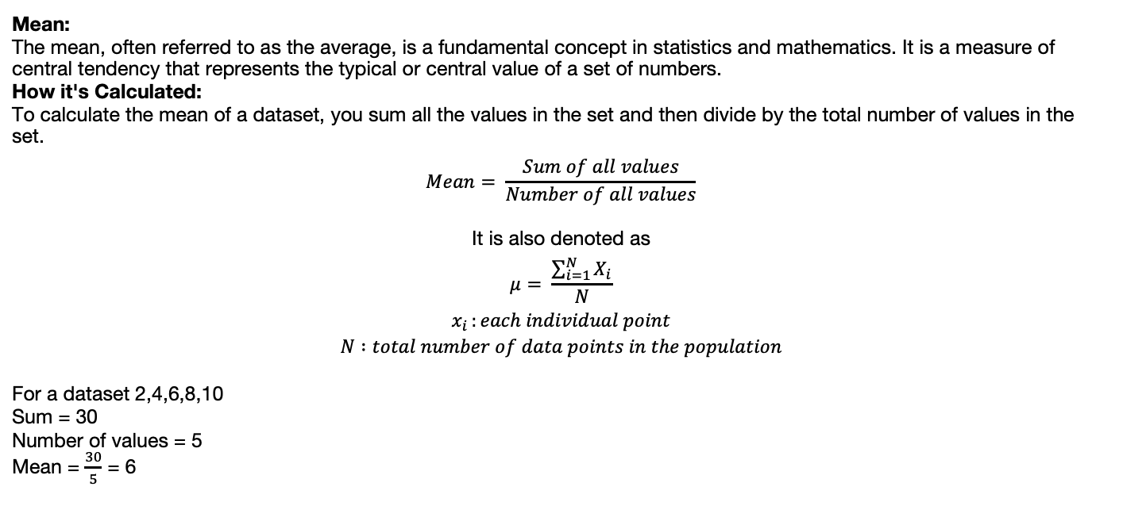
Basic Statistics
Mean:
The mean, often referred to as the average, is a fundamental concept in statistics and mathematics. It is a measure of central tendency that represents the typical or central value of a set of numbers.
How it's Calculated:
To calculate the mean of a dataset, you sum all the values in the set and then divide by the total number of values in the set.
$$Mean= \frac{Sum of all values}{Number of all values}$$
It is also denoted as
$$μ= \frac{\sum_{i=1}^{N}{X_{i}}}{N}$$
$$x_{i }:each individual point$$
$$N :total number of data points in the population$$
For a dataset 2,4,6,8,10
Sum = 30
Number of values = 5
Mean = $\frac{30}{5}$ = 6

Slide 50
Basic Statistics
Mean:
Key Characteristics
- Sensitivity to Outliers: The mean is sensitive to extreme values (outliers) in the dataset. A single very large or very small value can significantly affect the mean.
- Common Use: It is widely used in various fields, including science, economics, finance, and everyday life, to summarize data and understand typical performance or characteristics.
- Types of Mean: While the arithmetic mean is the most common, other types of means exist, such as the geometric mean and harmonic mean, used in specific contexts.

Slide 51
Basic Statistics
Mode:
The mode is another measure of central tendency in statistics. It represents the value that appears most frequently in a dataset. Unlike the mean or median, the mode can be used for both numerical and categorical data.
How it's Determined:
To find the mode, you simply identify the value (or values) that occurs with the highest frequency in the dataset.
Characteristics:
A dataset can have: No mode: If all values appear with the same frequency. One mode (unimodal): If one value appears most frequently. Two modes (bimodal): If two values appear with the same highest frequency.
Multiple modes (multimodal): If more than two values appear with the same highest frequency.
Not affected by outliers: The mode is not influenced by extreme values in the dataset, making it a robust measure for skewed distributions.
Applicable to all data types: It's the only measure of central tendency that can be used with nominal (categorical) data.

Slide 52
Basic Statistics
Mode:
Dataset with one mode:
3,5,7,7,8,9,10
The value 7 appears twice, which is more than any other value.
Mode: 7
Dataset with two modes (bimodal):
1,2,2,3,4,4,5
The values 2 and 4 both appear twice, which is the highest frequency.
Modes: 2,4
Dataset with no mode:
10,20,30,40,50
Each value appears only once.
Mode: No mode

Slide 53
Basic Statistics
Median:
The median is another important measure of central tendency in statistics. It represents the middle value in a dataset when the data is arranged in numerical order.
How it's determined:
Order the data: Arrange all the values in the dataset from smallest to largest (or largest to smallest).
Find the middle value:
If the number of values is odd: The median is the single middle value.
If the number of values is even: The median is the average (mean) of the two middle values.

Slide 54
Basic Statistics
Median:
The median is another important measure of central tendency in statistics. It represents the middle value in a dataset when the data is arranged in numerical order.
How it's determined:
Order the data: Arrange all the values in the dataset from smallest to largest (or largest to smallest).
Find the middle value:
If the number of values is odd: The median is the single middle value.
If the number of values is even: The median is the average (mean) of the two middle values.
The median is less affected by extreme outliers compared to the mean, making it a robust measure for skewed distributions.

Slide 55

Basic Statistics
Median
Odd number of values:
Dataset: 3,5,7,8,10
Ordered: 3,5,7,8,10
Median: 7
Even number of values:
Dataset: 2,4,6,8,10,12
Ordered: 2,4,6,8,10,12
Median:$\frac{6+8}{2}$ = 7

Slide 56
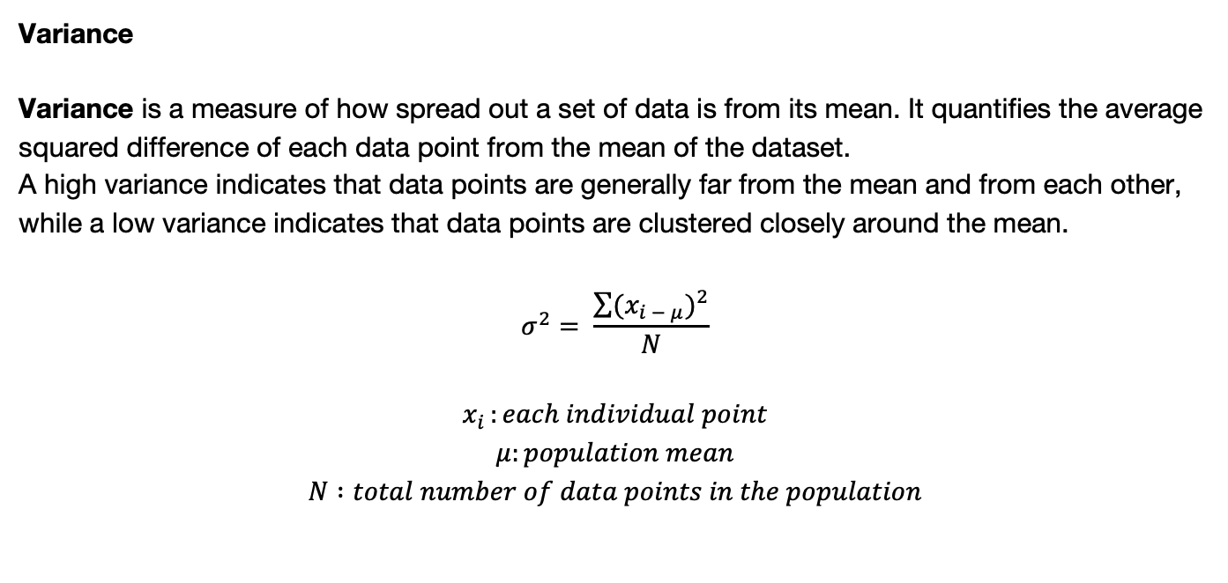
Basic Statistics
Variance
Variance is a measure of how spread out a set of data is from its mean. It quantifies the average squared difference of each data point from the mean of the dataset.
A high variance indicates that data points are generally far from the mean and from each other, while a low variance indicates that data points are clustered closely around the mean.
$$σ^{2}= \frac{\sum{{{(x}_{i − μ})}^{2}}}{N}$$
$$x_{i }:each individual point$$
$$μ:population mean$$
$$N :total number of data points in the population$$

Slide 57

Basic Statistics
Variance
For sample variance
$$s^{2}= \frac{\sum{{{(x}_{i }−\overline{x})}^{2}}}{N−1}$$
$$x_{i }:each individual point$$
$$\overline{x}:sample mean$$
$$N :total number of data points in the population$$

Slide 58
Basic Statistics
Variance
Key Characteristics
Measures Spread: Variance quantifies the dispersion or spread of data points around the mean.
Squared Differences: It's based on the squared differences from the mean. Squaring ensures that all deviations (both positive and negative) contribute positively to the variance and also penalizes larger deviations more heavily.
Units are Squared: The units of variance are the square of the units of the original data. For example, if the data is in meters, the variance will be in square meters. This can make direct interpretation somewhat challenging.
Always Non-Negative: Variance is always greater than or equal to zero. A variance of zero indicates that all data points are identical to the mean.
Sensitive to Outliers: Similar to the mean, variance is sensitive to outliers. Extreme values can significantly inflate the variance because their squared difference from the mean will be large.
Foundation for Standard Deviation: Variance is the square of the standard deviation, another widely used measure of spread. Standard deviation is often preferred for interpretation because it has the same units as the original data.

Slide 59
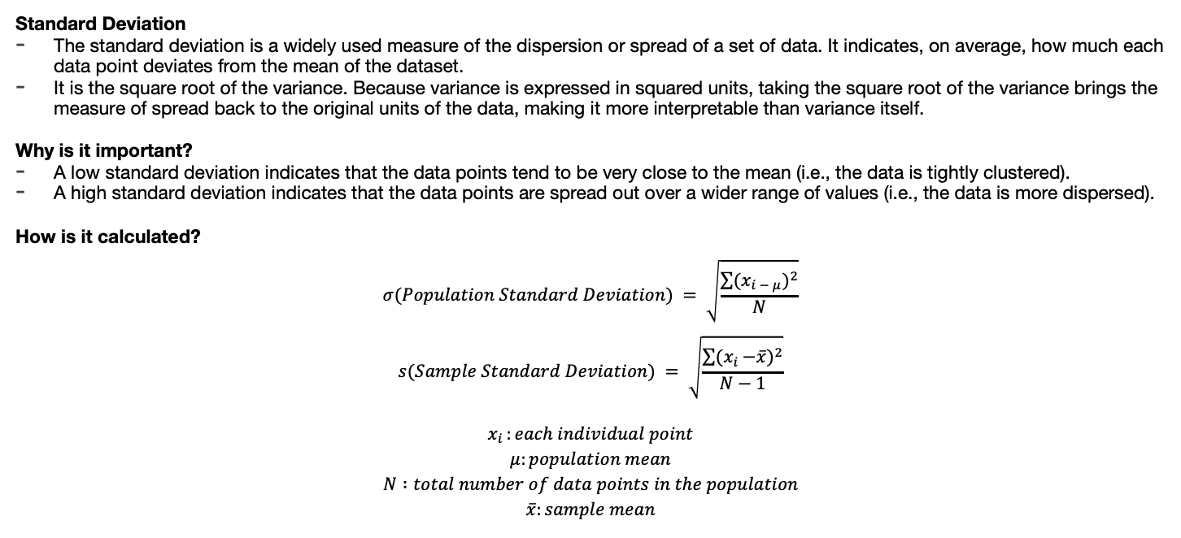
Basic Statistics
Standard Deviation
The standard deviation is a widely used measure of the dispersion or spread of a set of data. It indicates, on average, how much each data point deviates from the mean of the dataset.
It is the square root of the variance. Because variance is expressed in squared units, taking the square root of the variance brings the measure of spread back to the original units of the data, making it more interpretable than variance itself.
Why is it important?
A low standard deviation indicates that the data points tend to be very close to the mean (i.e., the data is tightly clustered).
A high standard deviation indicates that the data points are spread out over a wider range of values (i.e., the data is more dispersed).
How is it calculated?
$$σ(Population Standard Deviation) = \sqrt{\frac{\sum{{{(x}_{i − μ})}^{2}}}{N}}$$
$$s(Sample Standard Deviation) = \sqrt{\frac{\sum{{{(x}_{i }−\overline{x})}^{2}}}{N−1}}$$
$$x_{i }:each individual point$$
$$μ:population mean$$
$$N :total number of data points in the population$$
$$\overline{x}:sample mean$$

Slide 60
Basic Statistics
Standard Deviation
Key Characteristics of Standard Deviation:
- Measures Average Deviation: It provides a typical measure of how far individual observations are from the mean.
- Same Units as Data: Unlike variance, standard deviation is expressed in the same units as the original data, making it easier to understand and compare with the mean.
- Always Non-Negative: Like variance, standard deviation cannot be negative. A standard deviation of zero means all data points are identical and equal to the mean.
- Sensitive to Outliers: Because it's derived from variance, standard deviation is also sensitive to extreme values (outliers).
- Widely Used: It's one of the most common measures of variability and is fundamental in many statistical analyses, including hypothesis testing and confidence intervals.

Slide 61
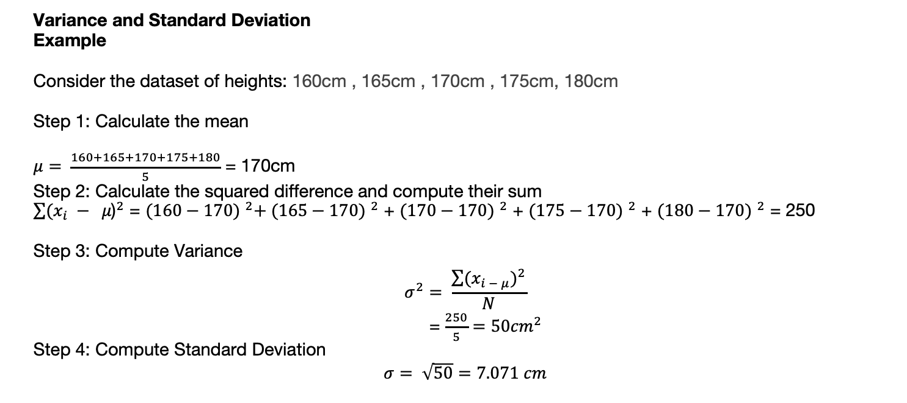
Basic Statistics
Variance and Standard Deviation
Example
Consider the dataset of heights: 160cm , 165cm , 170cm , 175cm, 180cm
Step 1: Calculate the mean
$μ= \frac{160+165+170+175+180}{5}$ = 170cm
Step 2: Calculate the squared difference and compute their sum
${\sum{(x_{i} − } μ\text{)}}^{2}$ = ${(160−170) }^{2}+ {(165−170) }^{2}$ + ${(170−170) }^{2}$ + ${(175−170) }^{2}$ + ${(180−170) }^{2}$ = 250
Step 3: Compute Variance
$$σ^{2}= \frac{\sum{{{(x}_{i − μ})}^{2}}}{N}$$
= $\frac{250}{5}=50{cm}^{2}$
Step 4: Compute Standard Deviation
$σ= \sqrt{50}=7.071 cm$

Slide 62
Basic Statistics
Random Variable:
A random variable is a variable whose value is a numerical outcome of a random phenomenon. It's a way to map the outcomes of a random experiment to numbers.
Consider the random experiment of flipping a fair coin twice. The sample space (all possible outcomes) is {HH, HT, TH, TT}.
We can define a random variable, let's call it (X), as the number of heads obtained. The mapping would be:
Outcome HH is mapped to (X = 2)
Outcome HT is mapped to (X = 1)
Outcome TH is mapped to (X = 1)
Outcome TT is mapped to (X = 0)

Slide 63
Basic Statistics
Characteristics of Random Variable:
Takes numerical values from random phenomena.
Each value has an associated probability distribution.
Maps sample space outcomes to real numbers.
Can be discrete (countable values) or continuous (range of values).
Has a mean (expected value) representing the average.
Has variance/standard deviation measuring data spread.
Can be independent of other random variables.

Slide 64
Basic Statistics
Types of Random Variable
Discrete Random Variable: A variable that can only take on a finite number of distinct values or a countably infinite number of distinct values (meaning the values can be listed, even if the list goes on forever).
Continuous Random Variable: A variable that can take on any value within a given range or interval on the real number line.
Categorical Random Variable: A variable whose values are categories or labels (though these are often numerically encoded for analysis).
Multivariate Random Variable (or Random Vector): A collection of two or more random variables defined on the same sample space, representing multiple outcomes of a random phenomenon simultaneously.

Slide 65
Basic Statistics
Examples of Random Variable
Discrete Random Variable: The number of heads obtained when flipping a coin 3 times (possible values: 0, 1, 2, 3).
Continuous Random Variable: The height of a randomly selected adult male (can take on any value within a certain range, e.g., 1.5 meters to 2.1 meters).
Categorical Random Variable: The blood type of a randomly selected person (possible values: A, B, AB, O).
Multivariate Random Variable (or Random Vector): Consider selecting a student at random and observing their height and weight. The random variable would be a pair (Height, Weight), e.g., (1.75 meters, 70 kg).

Slide 66
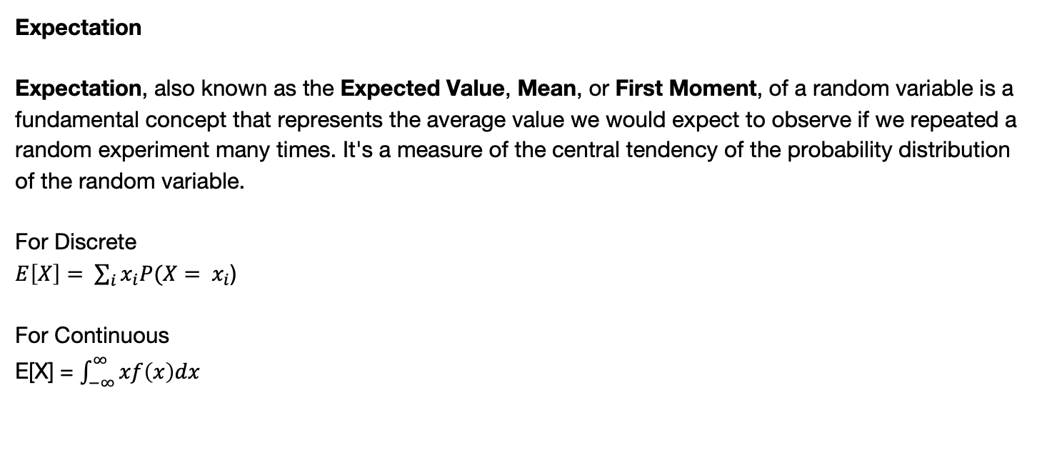
Basic Statistics
Expectation
Expectation, also known as the Expected Value, Mean, or First Moment, of a random variable is a fundamental concept that represents the average value we would expect to observe if we repeated a random experiment many times. It's a measure of the central tendency of the probability distribution of the random variable.
For Discrete
$E\left[X\right]= \sum_{i}{x_{i}P(X= }$ $x_{i}$)
For Continuous
E[X] = $\int_{−∞}^{∞}{xf\left(x\right)dx}$

Slide 67
Basic Statistics
Expectation
Key Characteristics
Linearity: For any random variables X and Y, and constants a and b: E[aX+bY]=aE[X]+bE[Y]
Expectation of a constant: Expectation of a constant is the constant itself E[c]=c
Scaler Multiplication: For a constant c and a random variable X: E[cX]=cE[X]
Addition of a constant: For a constant ‘c’ and a random variable X: E[X+c]=E[X]+c
Monotonicity If a random variable X is always less than or equal to another random variable Y (X≤Y), then their expected values maintain the same inequality : If P(X≤Y)=1, then E[X]≤E[Y]
Non Negativity: If a random variable X is always non-negative (X≥0), then its expected value is also non-negative

Slide 68
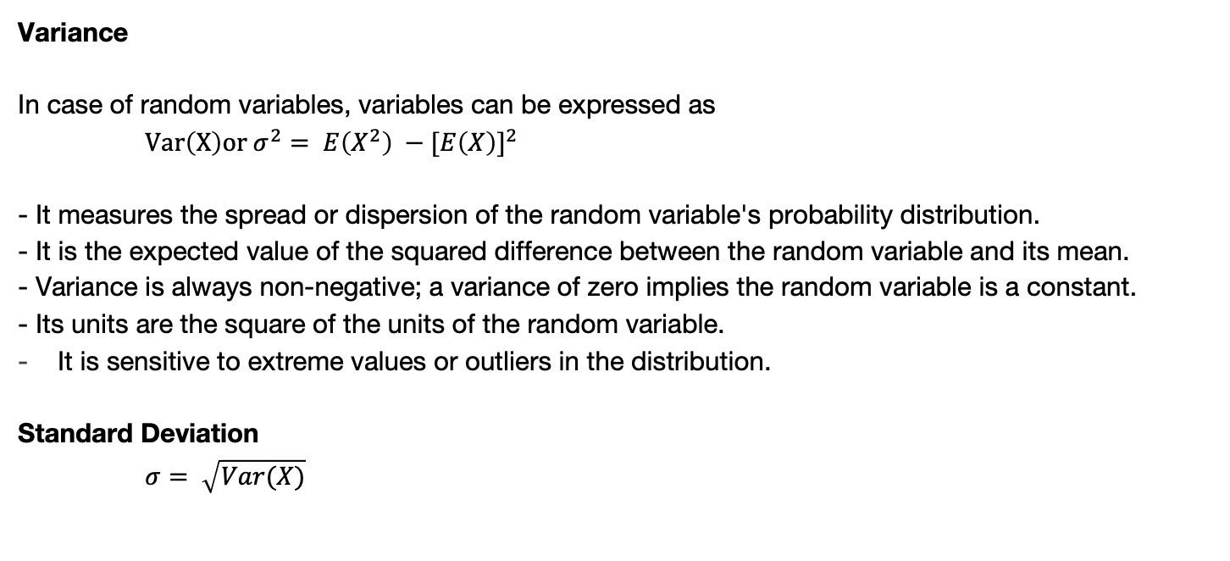
Basic Statistics
Variance
In case of random variables, variables can be expressed as
$Var\left(X\right)or σ^{2}= E\left(X^{2}\right) −{[E\left(X\right)]}^{2}$
- It measures the spread or dispersion of the random variable's probability distribution.
- It is the expected value of the squared difference between the random variable and its mean.
- Variance is always non-negative; a variance of zero implies the random variable is a constant.
- Its units are the square of the units of the random variable.
It is sensitive to extreme values or outliers in the distribution.
Standard Deviation
$σ= \sqrt{Var(X)}$

Slide 69
Basic Statistics
Covariance
Covariance is a measure of the joint variability of two random variables. It quantifies the degree to which two variables change together. In simpler terms, it tells us whether an increase in one variable tends to be associated with an increase or a decrease in the other variable.
Cov(X,Y) = E[XY] – E[X]E[Y]
Positive Covariance (Cov(X,Y)>0): Indicates that X and Y tend to increase or decrease together.
Negative Covariance (Cov(X,Y)<0): Indicates that as X increases, Y tends to decrease, and vice versa (an inverse relationship).
Zero Covariance (Cov(X,Y)=0): Suggests no linear relationship between X and Y. However, it's crucial to note that zero covariance does not imply independence; there might still be a non-linear relationship
The magnitude of the covariance is not easily interpretable as it depends on the units of X and Y. A large covariance doesn't necessarily mean a strong relationship, and a small covariance doesn't necessarily mean a weak relationship

Slide 70
Basic Statistics
Covariance
Key Characteristics
Symmetry: Cov(X,Y) = Cov(Y,X)
The covariance of a random variable with a constant is always zero because a constant has no variability, i.e., Cov(X,c)=0
Linear Transformation Cov(aX,Y)=aCov(X,Y) Cov(X+a,Y)=Cov(X,Y) Cov(aX+b,cY+d)=acCov(X,Y)
The covariance of a random variable with itself is its variance

Slide 71
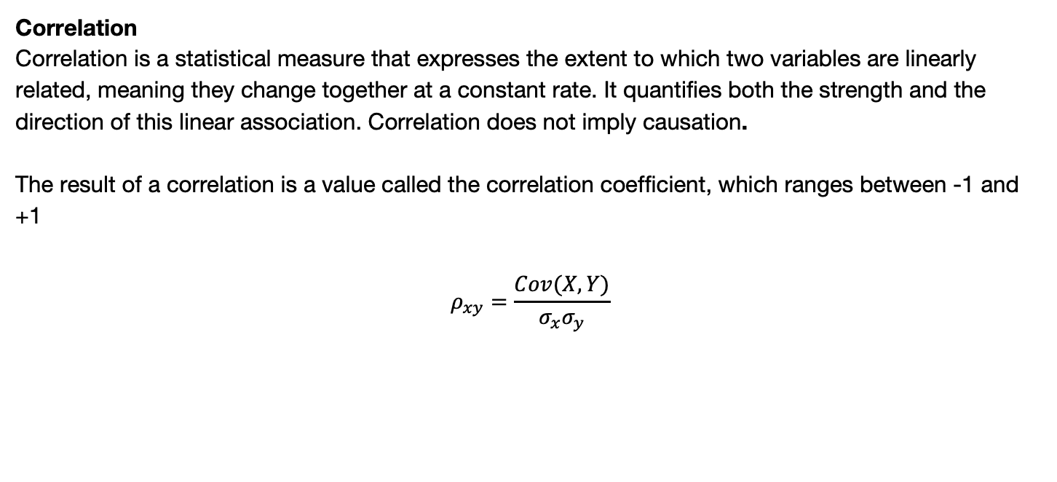

Basic Statistics
Correlation
Correlation is a statistical measure that expresses the extent to which two variables are linearly related, meaning they change together at a constant rate. It quantifies both the strength and the direction of this linear association. Correlation does not imply causation.
The result of a correlation is a value called the correlation coefficient, which ranges between -1 and +1
$$ρ_{xy}=\frac{Cov(X,Y)}{σ_{x}σ_{y}}$$
$$σ:is standard deviation$$
Cov(X,Y) is the covariance of X and Y

Slide 72
Basic Statistics
Problem 1
Consider the dataset:
X | Y | P(X,Y)
0 | 0 | 0.2
0 | 1 | 0.1
1 | 0 | 0.3
1 | 1 | 0.4
Questions:
a) The expected value of X and the expected value of Y.
b) The covariance of X and Y
c) The correlation coefficient between X and Y

Slide 73
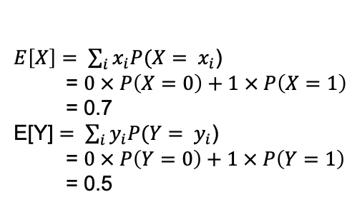
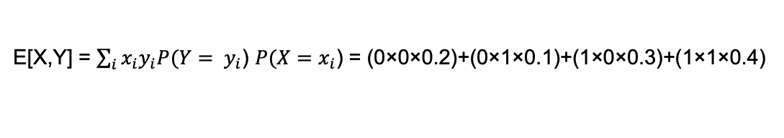
Basic Statistics
Problem 1
Consider the dataset:
a) The expected value of X and the expected value of Y.
$E\left[X\right]= \sum_{i}{x_{i}P(X= }$ $x_{i}$)
= $0 × P\left(X=0\right)+1 × P\left(X=1\right)$
= 0.7
E[Y] $= \sum_{i}{y_{i}P(Y= }$ $y_{i}$)
= $0 × P\left(Y=0\right)+1 × P\left(Y=1\right)$
= 0.5
X | Y | P(X,Y)
0 | 0 | 0.2
0 | 1 | 0.1
1 | 0 | 0.3
1 | 1 | 0.4
b) The covariance of X and Y
Cov(X,Y) = E[XY] – E[X]E[Y]
E[X,Y] = $\sum_{i}{{x_{i}y}_{i}P(Y= }$ $y_{i}$) $P(X=x_{i}$) = (0×0×0.2)+(0×1×0.1)+(1×0×0.3)+(1×1×0.4)
Cov(X,Y) = 0.4 – 0.35 = 0.05

Slide 74
Basic Statistics
data = [12, 15, 12, 15, 18, 21, 15, 17, 18, 20]
# Function to calculate Mean
def calculate_mean(data):
return sum(data) / len(data)
# Function to calculate Median
def calculate_median(data):
sorted_data = sorted(data)
n = len(sorted_data)
mid = n // 2
if n % 2 == 0:
return (sorted_data[mid - 1] + sorted_data[mid]) / 2
else:
return sorted_data[mid]

Slide 75
Basic Statistics
# Function to calculate Mode
def calculate_mode(data):
freq = {}
for num in data:
freq[num] = freq.get(num, 0) + 1
max_freq = max(freq.values())
modes = [key for key, val in freq.items() if val == max_freq]
if len(modes) == len(freq):
return "No mode"
return modes
# Function to calculate Variance
def calculate_variance(data):
mean = calculate_mean(data)
squared_diffs = [(x - mean) ** 2 for x in data]
return sum(squared_diffs) / len(data)

Slide 76
Basic Statistics
# Function to calculate Standard Deviation
def calculate_std_deviation(data):
variance = calculate_variance(data)
return variance ** 0.5
# Calculating all statistics
mean = calculate_mean(data)
median = calculate_median(data)
mode = calculate_mode(data)
variance = calculate_variance(data)
std_dev = calculate_std_deviation(data)

Slide 77
Basic Statistics
# Display results
print("Dataset:", data)
print("Mean:", mean)
print("Median:", median)
print("Mode:", mode)
print("Variance:", variance)
print("Standard Deviation:", std_dev)
Output
Dataset: [12, 15, 12, 15, 18, 21, 15, 17, 18, 20]
Mean: 16.3
Median: 16.5
Mode: [15]
Variance: 8.609999999999998
Standard Deviation: 2.9325756597230376

Slide 78
Basic Statistics
#Joint Probability Data
joint_prob = {
(1, 2): 0.10,
(1, 3): 0.15,
(2, 2): 0.20,
(2, 3): 0.25,
(3, 2): 0.10,
(3, 3): 0.20
}
# Marginal distributions
def marginal_probs(joint_prob):
px = {}
py = {}
for (x, y), p in joint_prob.items():
px[x] = px.get(x, 0) + p
py[y] = py.get(y, 0) + p
return px, py

Slide 79
Basic Statistics
# Expectation of X
def expected_value(var, prob_dist):
return sum(val * prob for val, prob in prob_dist.items())
# Variance of X or Y
def variance(var, prob_dist, mean):
return sum(((val - mean) ** 2) * prob for val, prob in prob_dist.items())
# Covariance of X and Y
def covariance(joint_prob, mean_x, mean_y):
cov = 0
for (x, y), p in joint_prob.items():
cov += (x - mean_x) * (y - mean_y) * p
return cov

Slide 80
Basic Statistics
# Correlation of X and Y
def correlation(cov, std_x, std_y):
if std_x == 0 or std_y == 0:
return 0 # avoid division by zero
return cov / (std_x * std_y)
# Calculations
px, py = marginal_probs(joint_prob)
mean_x = expected_value('X', px)
mean_y = expected_value('Y', py)
var_x = variance('X', px, mean_x)
var_y = variance('Y', py, mean_y)
std_x = var_x ** 0.5
std_y = var_y ** 0.5

Slide 81
Basic Statistics
cov_xy = covariance(joint_prob, mean_x, mean_y)
corr_xy = correlation(cov_xy, std_x, std_y)
# Output
print("E[X]:", round(mean_x, 4))
print("E[Y]:", round(mean_y, 4))
print("Var(X):", round(var_x, 4))
print("Var(Y):", round(var_y, 4))
print("Cov(X, Y):", round(cov_xy, 4))
print("Corr(X, Y):", round(corr_xy, 4))
Output
E[X]: 2.15
E[Y]: 2.65
Var(X): 0.6275
Var(Y): 0.2275
Cov(X, Y): 0.2875
Corr(X, Y): 0.7548

Slide 82
Visualizing Data using Python Libraries
Why Data Visualization Matters
Translates raw data into visual context: Data visualization makes raw data understandable through visual representation
Helps identify trends, patterns, and outliers: Visuals reveal insights hidden within data distributions
Essential for data storytelling and decision-making: Visualizations communicate data narratives effectively for informed choices
Makes complex data accessible: Data visualization simplifies intricate information for broader comprehension

Slide 83
Visualizing Data using Python Libraries
Popular Visualization Libraries
Matplotlib: Foundational plotting library
Seaborn: High-level API for statistical plots
Pandas: Built-in plotting for DataFrames
Plotly: Interactive, web-based plots

Slide 84
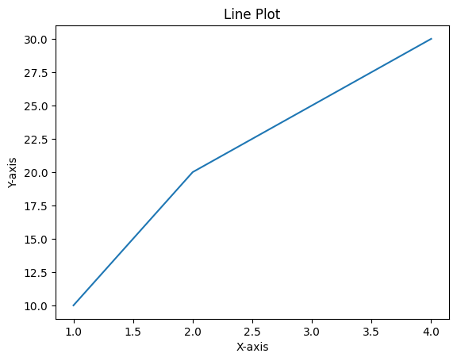
Visualizing Data using Python Libraries
Getting Started with Matplotlib
import matplotlib.pyplot as plt
plt.plot([1, 2, 3, 4], [10, 20, 25, 30])
plt.title("Line Plot")
plt.xlabel("X-axis")
plt.ylabel("Y-axis")
plt.show()

Slide 85
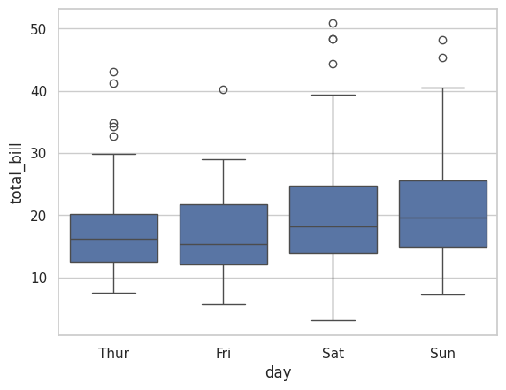
Visualizing Data using Python Libraries
Getting Started with Seaborn
import seaborn as sns
sns.set(style="whitegrid")
tips = sns.load_dataset("tips")
sns.boxplot(x="day", y="total_bill", data=tips)

Slide 86
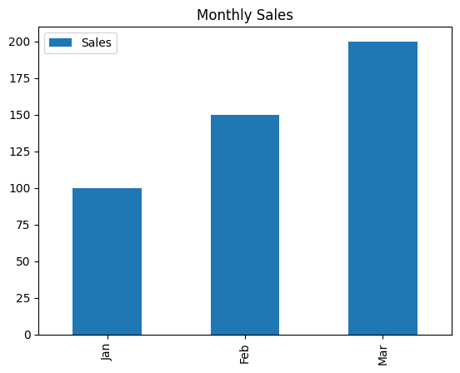
Visualizing Data using Python Libraries
Drawing Linegraph using
import seaborn as sns
sns.set(style="whitegrid")
tips = sns.load_dataset("tips")
sns.boxplot(x="day", y="total_bill", data=tips)

Slide 87
Visualizing Data using Python Libraries
Drawing Linegraph using
import seaborn as sns
sns.set(style="whitegrid")
tips = sns.load_dataset("tips")
sns.boxplot(x="day", y="total_bill", data=tips)

Slide 88
Visualizing Data using Python Libraries
Interactive Plots with Plotly
import plotly.express as px
import seaborn as sns
import pandas as pd
# Load the 'tips' dataset from seaborn
tips = sns.load_dataset("tips")
# Create an interactive scatter plot
fig = px.scatter(
tips,
x="total_bill",
y="tip",
color="sex",
title="Scatter Plot of Total Bill vs Tip by Gender",
labels={"total_bill": "Total Bill ($)", "tip": "Tip Amount ($)", "sex": "Gender"},
template="plotly_white"
)
# Show the plot
fig.show()

Slide 89
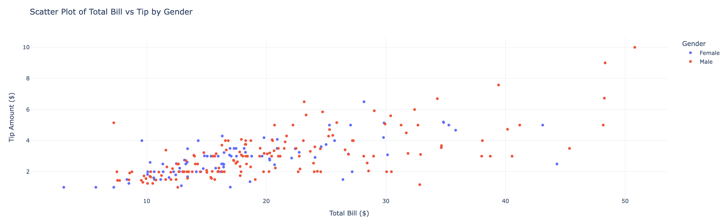
Visualizing Data using Python Libraries

Slide 90
Choosing the Right Chart
Chart Type | Use Case
Line Chart | Trends over time
Bar Chart | Comparing categories
Pie Chart | Part-to-whole relationships
Boxplot | Distribution and outliers
Scatter Plot | Relationship between two variables
Heatmap | Correlation matrix / density

Slide 91
Best Practices
Label axes and include titles
Avoid chart junk (too many elements)
Use appropriate color schemes
Keep interactivity for complex data
Choose the right plot for the question

Slide 92
Summary

Slide 93
Summary
01
Basics of Python
02
Programming Paradigms of Python
03
Basic Statistics

